Slide 1
Plasma Diagnostic Techniques:
Langmuir probe
Presenter: Kari Niemi
Material: Jérôme Bredin
Academic: Deborah O’Connell
York Plasma Institute
Notes:
1

Slide 2
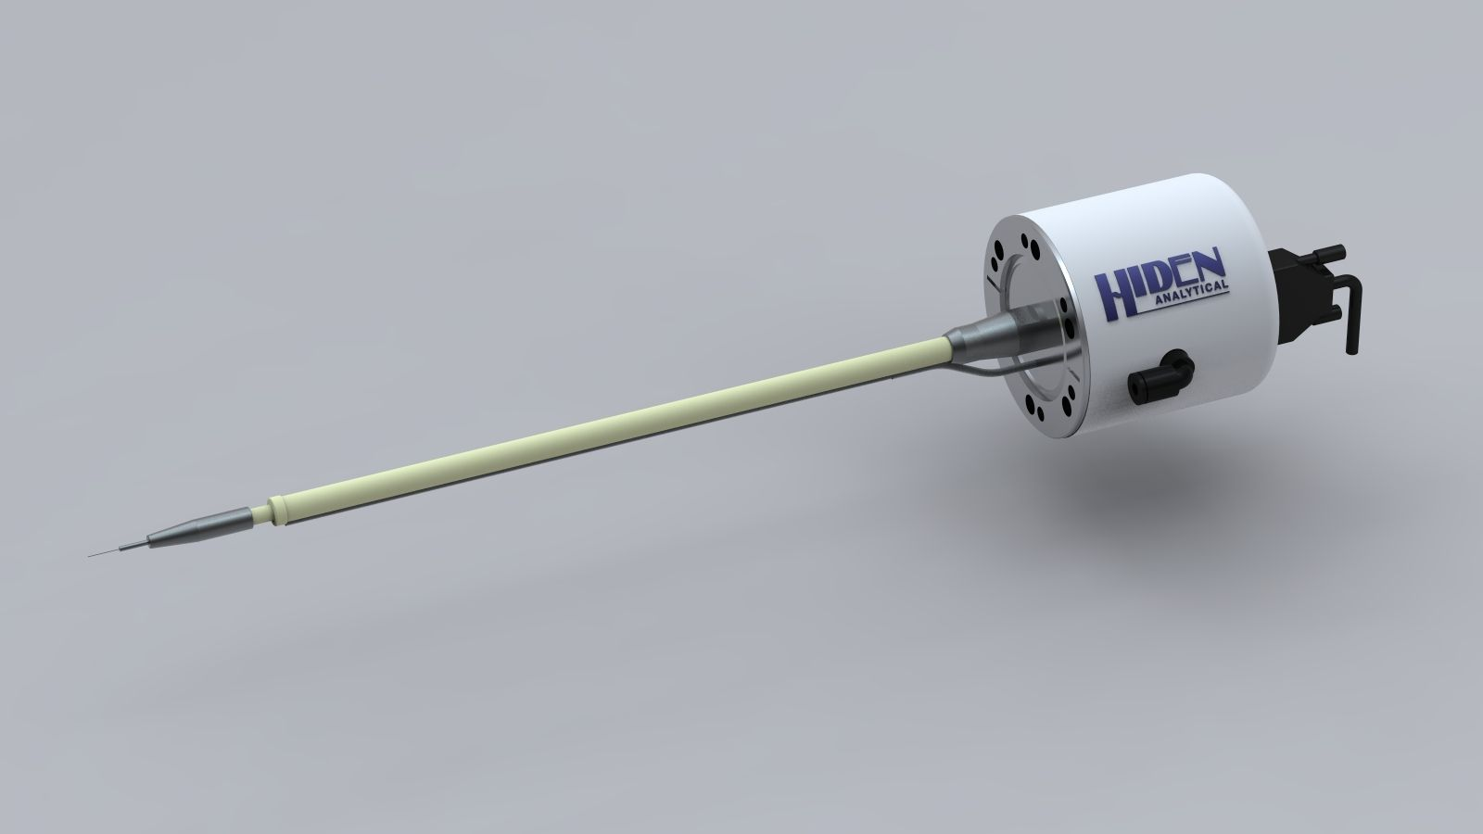
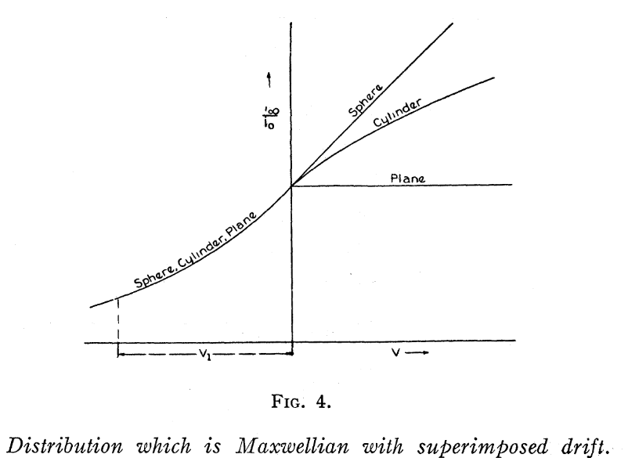
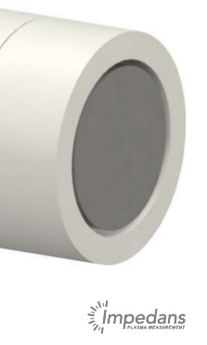
Historical Overview
Electrostatic probe diagnostic
Mott-Smith and Langmuir, Phys. Rev. (1926)

Slide 3
Principle
Current
Electrodes
I_{sat.e}
Plasma
Expectation
RF
LP
V_{f}
V_{p}
Potential
I_{sat.i}
V
Electron saturation current
I
I
Reality
R_{m}
Floating potential
Plasma potential
V_{f}
V_{p}
V
Ion saturation current

Slide 4
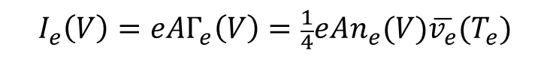
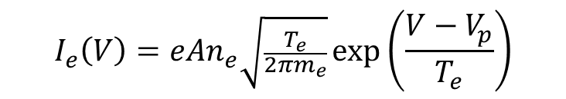
Electron Collection Region
I
Collected electron current
$$I_{e}\left(V\right)=eAΓ_{e}\left(V\right)=\frac{1}{4}eAn_{e}(V)\overline{v_{e}}(T_{e})$$
A probe surface area
Γ_{e} collected electron flux
n_{e} electron density
v_{e} mean thermal electron velocity
V_{f}
V_{p}
V
For Maxwellian electron energy distribution:
Only electrons with energy E > V_{p} – V can reach the probe
Information on electrons energy distribution
$$I_{e}\left(V\right)=eAn_{e}\sqrt{\frac{T_{e}}{2πm_{e}}}\exp\left(\frac{V−V_{p}}{T_{e}}\right)$$

Slide 5
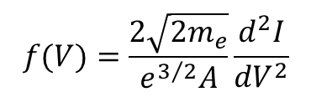
Electron Energy distribution
$$f(V)=\frac{2\sqrt{2m_{e}}}{e^{3/2}A}\frac{d^{2}I}{dV^{2}}$$
Collected current (A)
EEPF (eV^{-3/2}cm⁻³)
Probe potential (V)
Plasma requirements:
weakly-ionized (non-thermal)
plasma sheath collision-less for electrons (low-pressure)
isotropic EED (non-magnetized plasma).

Slide 6
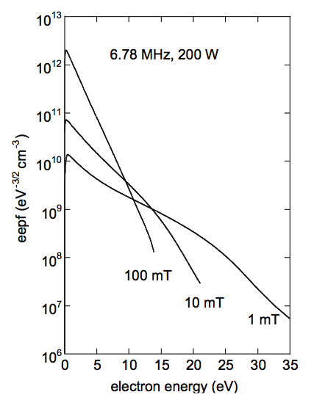
Non-thermal EED
Low pressure
Cold electrons trapped in the bulk
Electrons above V_{p} depleted, since they can escape
High pressure
Thermalization through e-e collisions
Depletion above ionisation threshold (highly inelastic collisions)
Maxwellian
non-Maxwellian
Maxwellian distribution
electrons in thermo-dynamical equilibrium
characterised by ‘one’ electron temperature (slope of EEPF)
V. Godyak and V. Demidov, J. Phys. D: Appl. Phys. (2011)

Slide 7
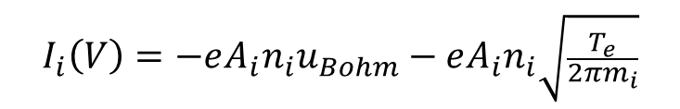
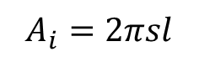
Ion Collection Region
I
plasma bulk
pre-sheath
sheath
V_{p}
wall
Plasma potential
n_{i}
n_{e}
V_{f}
V_{p}
V
0
Distance to centre
$$I_{i}\left(V\right)=−eA_{i}n_{i}u_{Bohm}−eA_{i}n_{i}\sqrt{\frac{T_{e}}{2πm_{i}}}$$
Langmuir probe tip
s
For non-planar probes, the ion collection area depends on the sheath width, which increases with the bias voltage, leading to a continuous increase in ion current (above the actual saturation value).
l
$$A_{i}=2πsl$$
Notes:
7

Slide 8
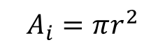
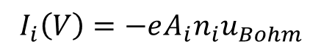
Ion Saturation Region
I
Planar probe
s
_{r}
Guard ring
V_{f}
V_{p}
V
$$I_{i}\left(V\right)=−eA_{i}n_{i}u_{Bohm}$$
For a planar probe, the ion collection area is independent off the sheath width, which allows an independent calculation of the ion density.
$$A_{i}=πr^{2}$$
Notes:
8

Slide 9
Plasma oscillations, RF plasmas
Particularly in capacitively-coupled radio-frequency driven plasmas, the characteristic voltage potentials within the plasma bulk region oscillate substantially on the driving frequency.
I
Time averaged I-V probe curve yields ‘too high’ electron temperature
V
ϕ_{P}
t
M. Lieberman, A. Lichtenberg, John Wiley and Sons, New York (2005)

Slide 10
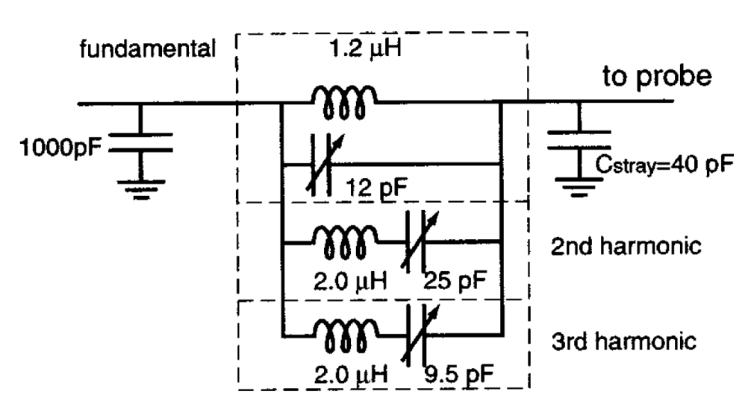
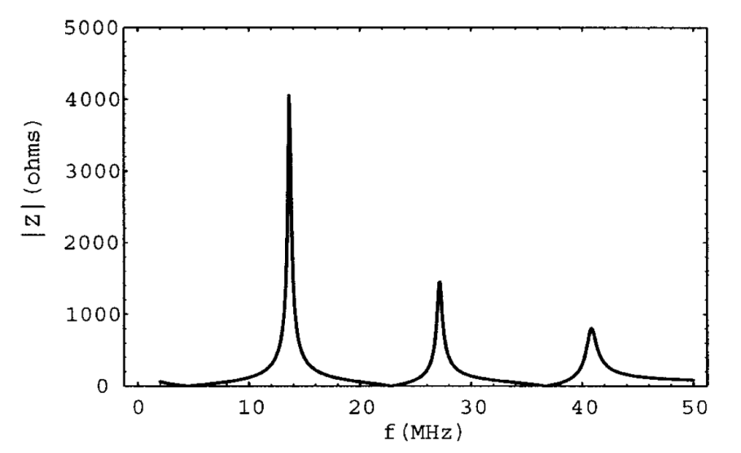
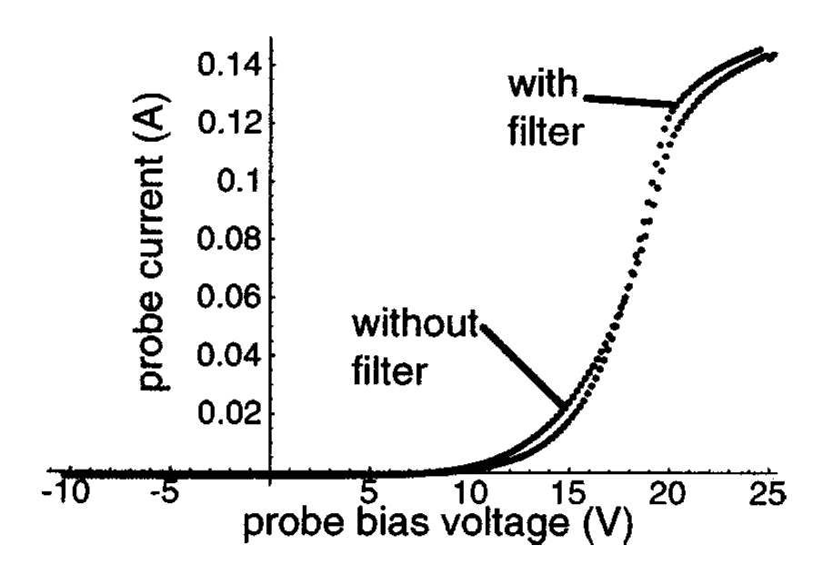
Probe Compensation
Block potential oscillations on the driving frequency and its higher harmonics (due to non-linear nature of plasma sheath) by electrical filters in probe circuit.

Slide 11
Summary
Pros
Instrumentation: Simple
Resolution: Local & not highly time-resolved
Method: Direct
Cons
Interpretation: Based on plasma sheath models
Diagnostic: Intrusive
Limitations: (1) harsh environments (damage), (2) complex chemistry (multi-species/electro-negative), (3) higher pressure environments (theory)

Slide 12
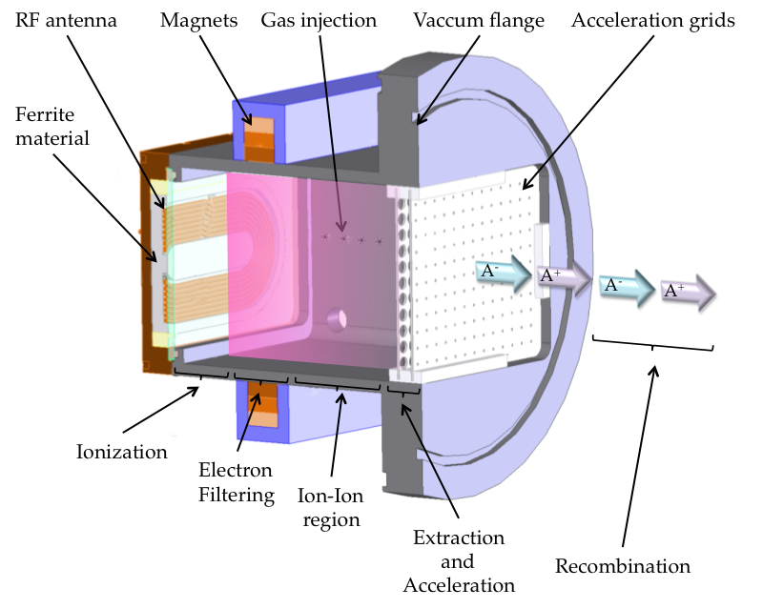
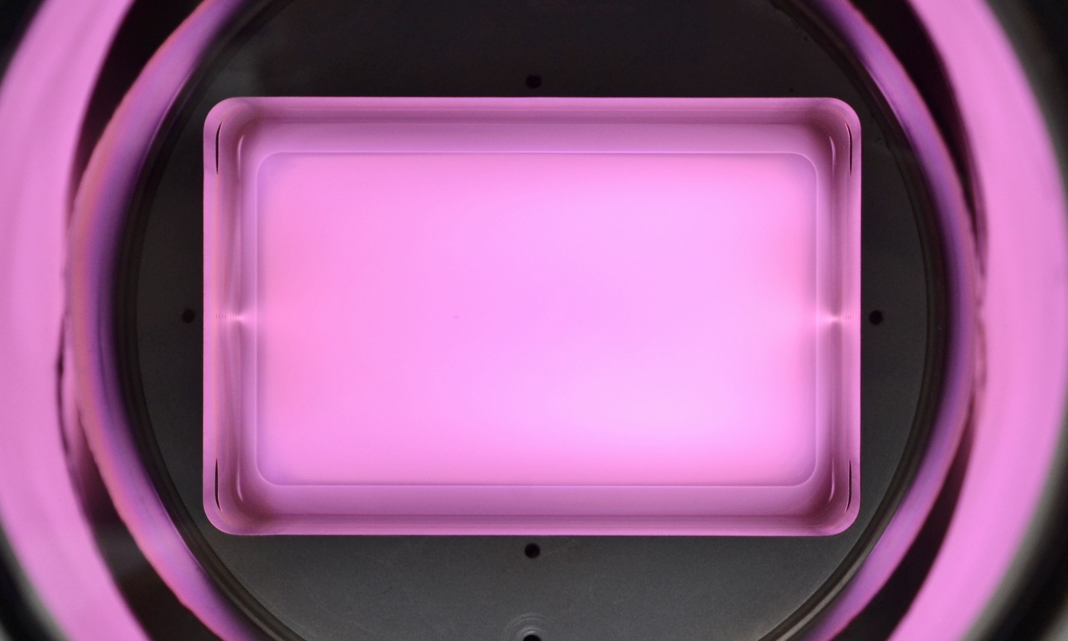
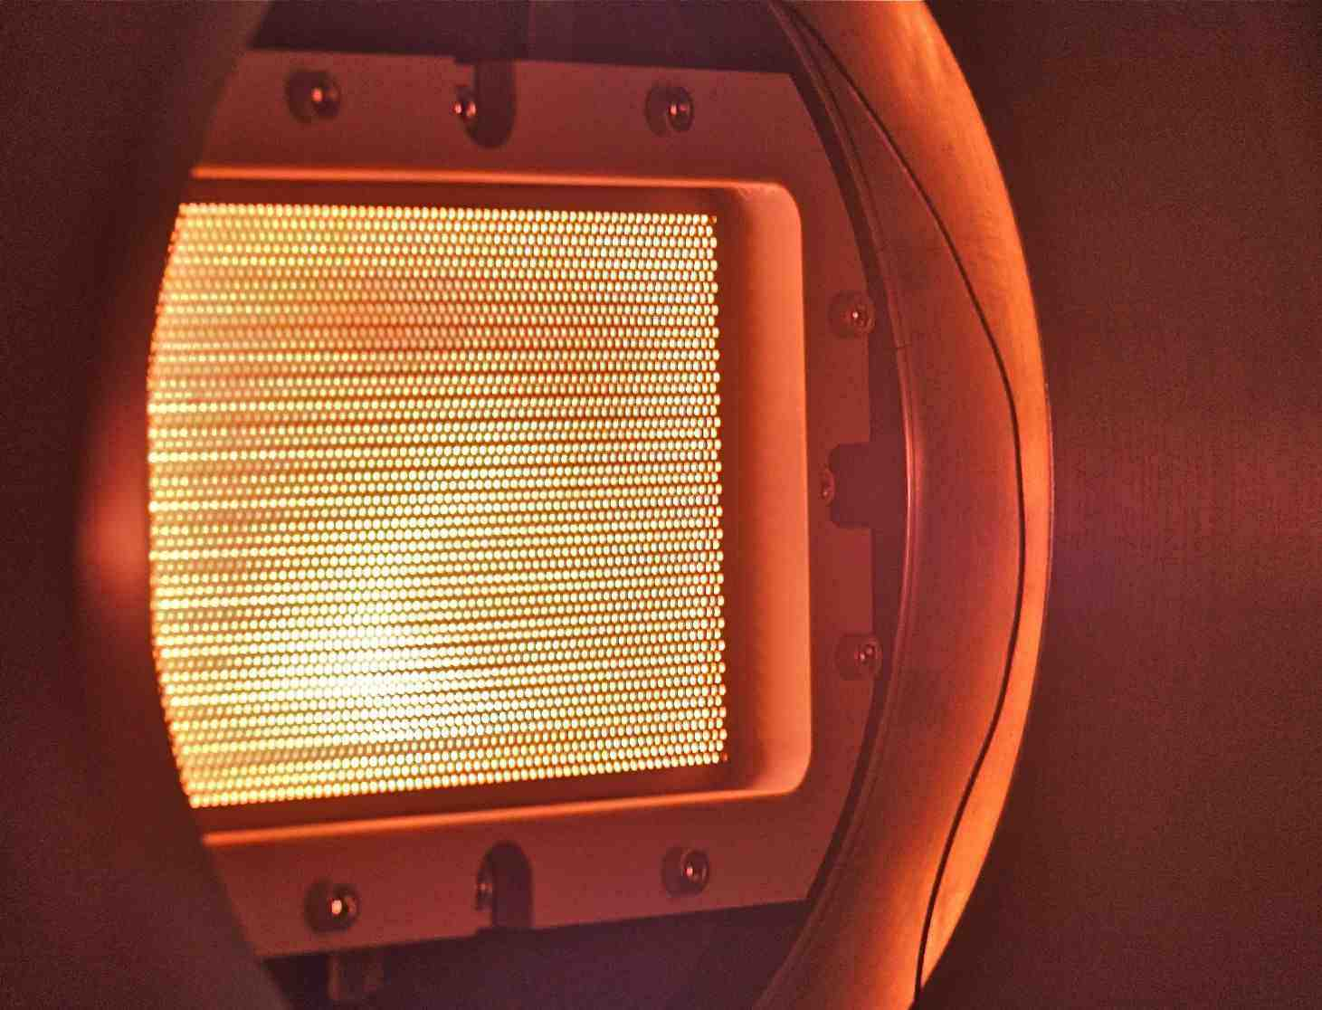

Application
Plasma Propulsion with Electronegative GASES (PEGASES thruster)

Slide 13
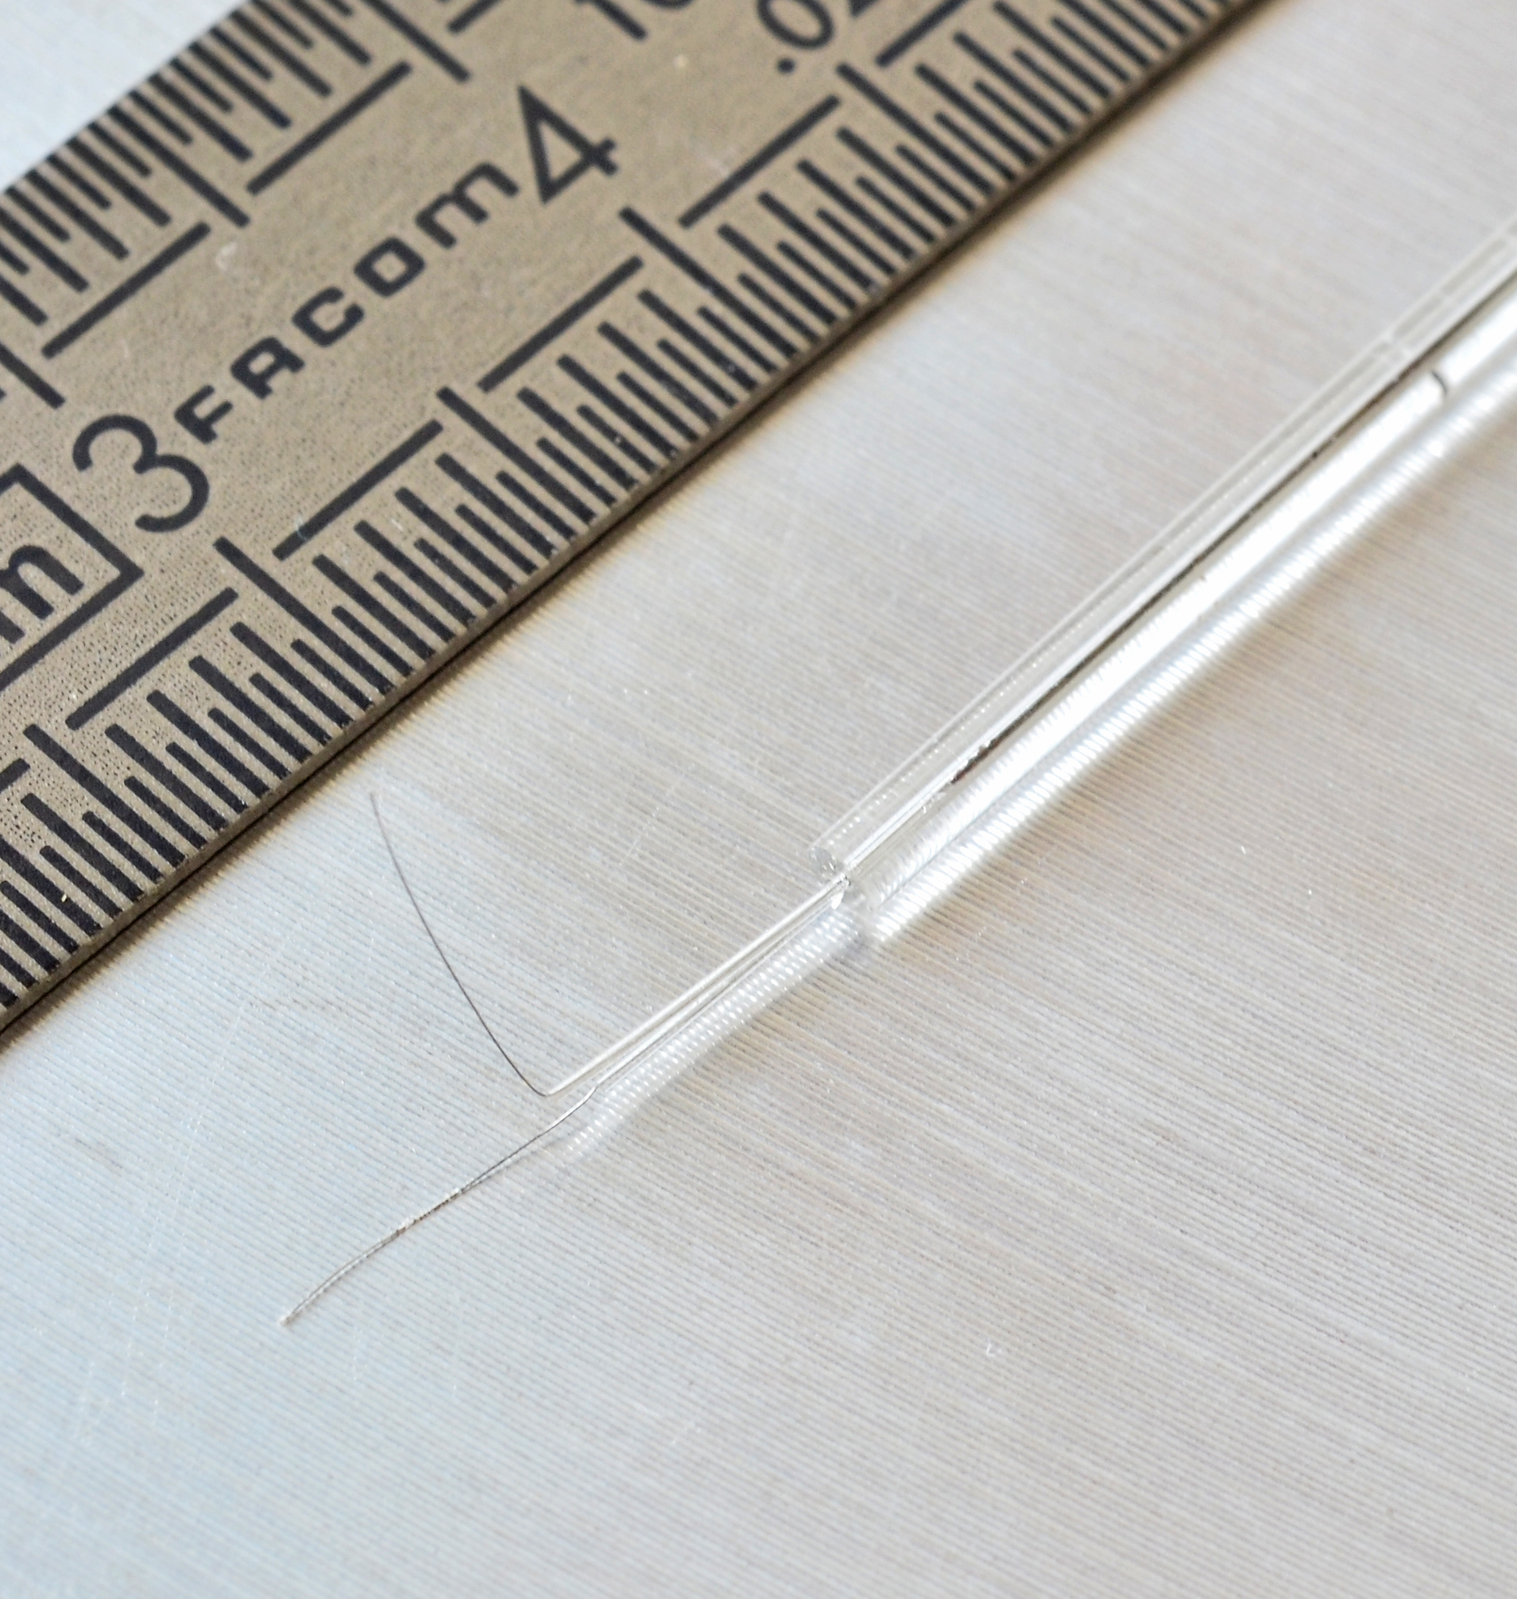
Application
Experiment requirements:
Measurements ⊥ B
R_{a} = 0.025 mm < R_{Le} = 0.1 mm
Measurement:
Tips : Platinum-Iridium
Tip ⊥ B ⇒ measure
Tip // B ⇒ reference
No passive filter
∅ = 0.20 mm
// B
∅ = 1.65 mm
∅ = 0.20 mm
⊥ B
l = 6 mm
∅ = 0.05 mm

Slide 14
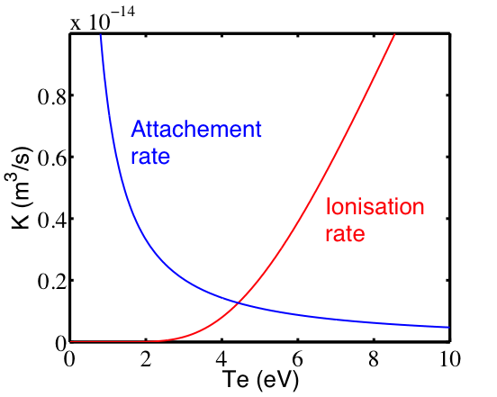
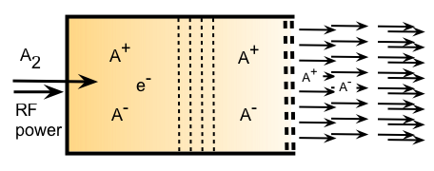
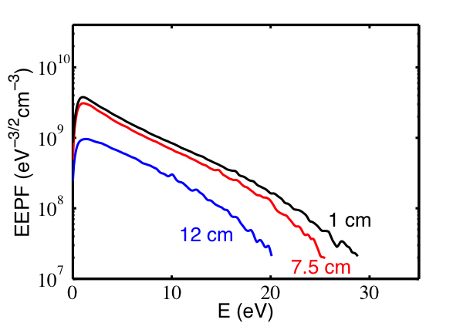
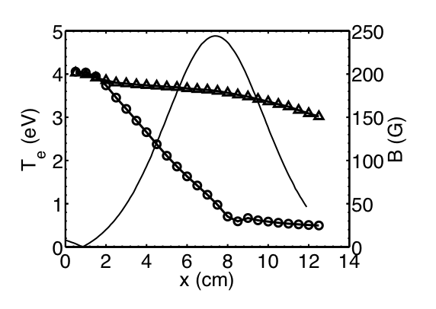
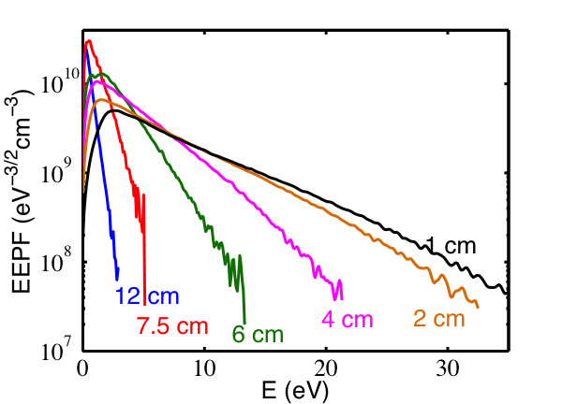
Application
SF6 ion prod. rates
Without magnetic filter High Te ~ 5 eV suppresses formation of negative ions
With magnetic filter Lowered Te ~ 2eV enables formation of negative ions

